Slide 1

DEPI AWS Graduation Project
Project 9 & 10 & 11

Slide 2

Agenda
Project Assignment
Project 9: Creating An Amazon Virtual Private Cloud
Project 10: Creating A VPC Peering Connection
Project 11: Securing Applications Using Amazon Cognito
Q & A

Slide 3
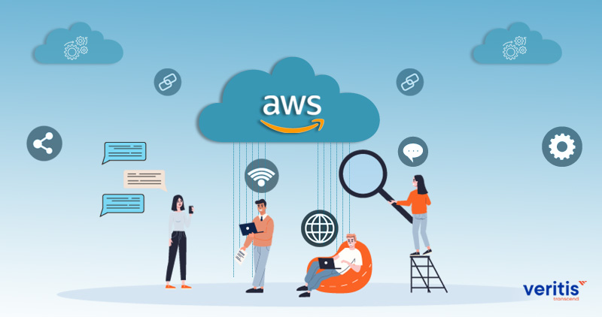
Project Assignment
Assign to: Esraa Atef Eldegwy
Project 9: Creating An Amazon Virtual Private Cloud
Assign to Ahmed Khaled Ahmed
Project 10: Creating A VPC Peering Connection
Assign to Yousef Ashraf AbdelRazek & Ashraf Abdo Abdo
Project 11: Securing Applications Using Amazon Cognito

Slide 4

Project 9: Creating An Amazon Virtual Private Cloud
Presented By: Esraa Atef Eldegwy

Slide 5
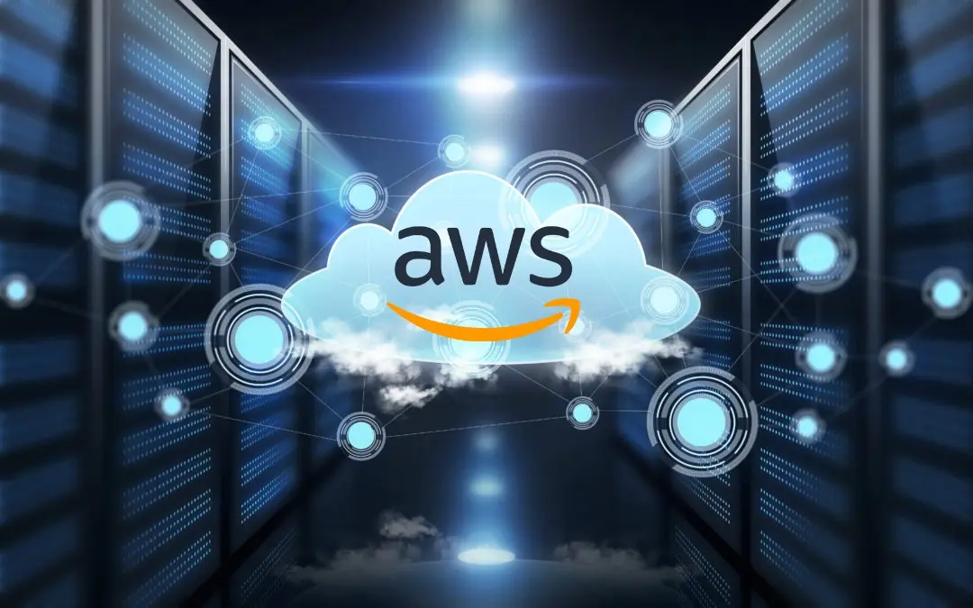
Project Overview
This project demonstrates how to create a Virtual Private Cloud (VPC) using Amazon VPC, enabling you to deploy a secure private network in AWS. You will learn to create a VPC, set up public and private subnets, attach an internet gateway, and launch an application server to test the VPC configuration.
Project Tasks:
Deploy a VPC.
Create public and private subnets.
Set up an internet gateway and attach it to the VPC.
Configure route tables for public internet access.
Launch an application server to validate the VPC setup.

Slide 6
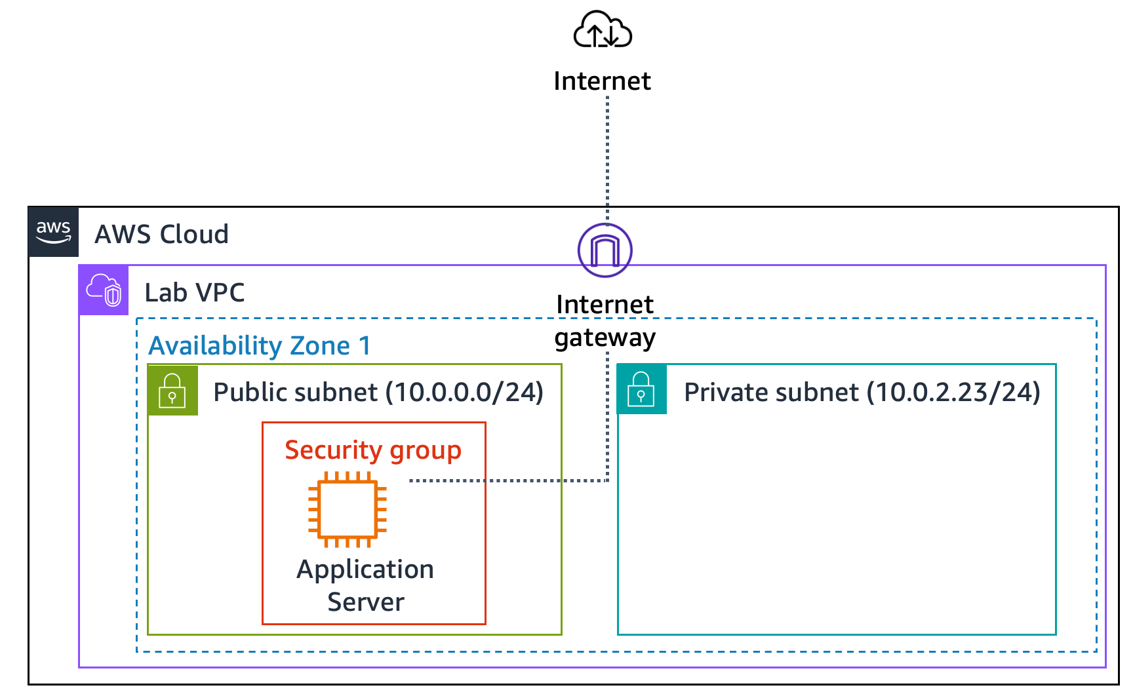
Project Diagram

Slide 7
Task 1: Creating a VPC
A VPC is a virtual network that is dedicated to your Amazon Web Services (AWS) account.
It is logically isolated from other virtual networks in the AWS Cloud. You can launch AWS resources, such as Amazon Elastic Compute Cloud (Amazon EC2) instances, into the VPC.
You can configure the VPC by modifying its IP address range and create subnets. You can also configure route tables, network gateways, and security settings.

Slide 8
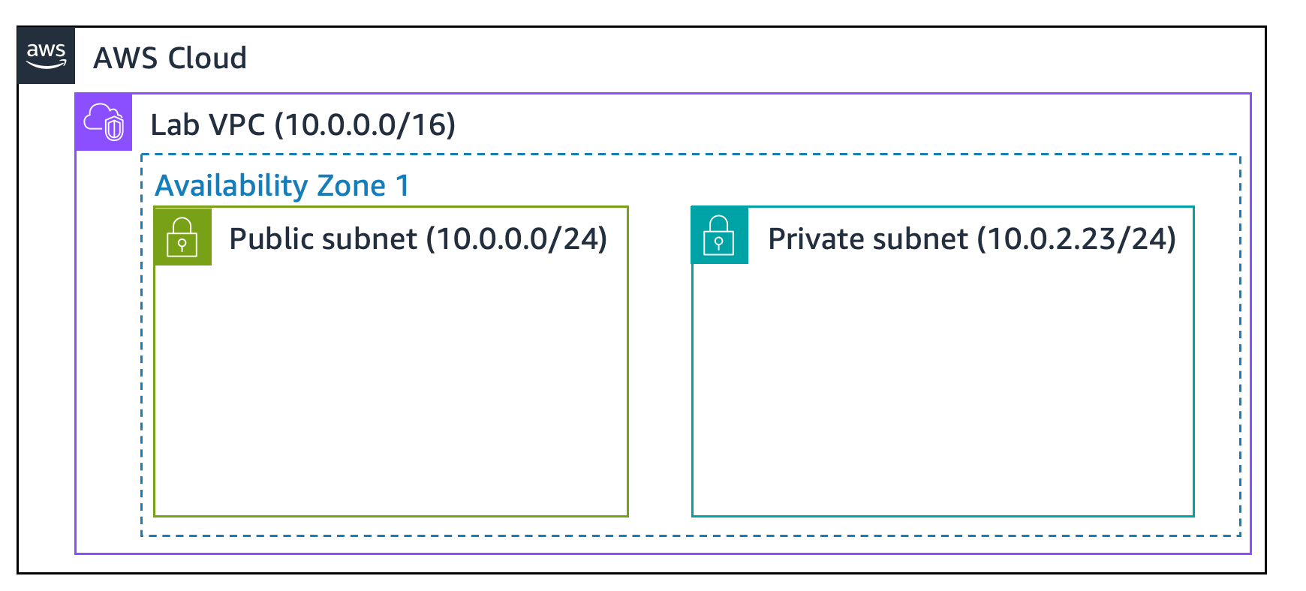
Task 2: Creating Subnets
A subnet is a subrange of IP addresses in the VPC. AWS resources can be launched into a specified subnet. Use a public subnet for resources that must be connected to the internet and use a private subnet for resources that must remain isolated from the internet.
In this task, will create a public subnet and a private subnet

Slide 9
Task 3: Creating an Internet Gateway
An internet gateway is a horizontally scaled, redundant, and highly available VPC component. It allows communication between the instances in a VPC and the internet. It imposes no availability risks or bandwidth constraints on network traffic.
An internet gateway serves two purposes:
To provide a target in route tables that connects to the internet
To perform network address translation (NAT) for instances that were assigned public IPv4 addresses
In this task we will do the following:
Create an internet gateway named Lab IGW.
Attach the internet gateway to the Lab VPC.

Slide 10
Task 4: Configuring Route Tables
A route table contains a set of rules, called routes, that are used to determine where network traffic is directed.
Each subnet in a VPC must be associated with a route table because the table controls the routing for the subnet.
A subnet can be associated with only one route table at a time, but you can associate multiple subnets with the same route table.
To use an internet gateway, a subnet's route table must contain a route that directs internet-bound traffic to the internet gateway. If a subnet is associated with a route table that has a route to an internet gateway, it is known as a public subnet.
In this task, you do the following:
Create a public route table for internet-bound traffic.
Add a route to the route table to direct internet-bound traffic to the internet gateway.
Associate the public subnet with the new route table.

Slide 11
Task 5: Creating a Security Group for the Application Server
A security group acts as a virtual firewall for instances to control inbound and outbound traffic.
Security groups operate at the level of the elastic network interface for the instance. Security groups do not operate at the subnet level. Thus, each instance can have its own firewall that controls traffic.
If you do not specify a particular security group at launch time, the instance is automatically assigned to the default security group for the VPC.
In this task, you create a security group that gives users the ability to access your application server through HTTP.
Create a security group named App-SG to allow HTTP traffic:
Inbound Rule: Allow HTTP (port 80) from Anywhere (0.0.0.0/0).
This security group will be used by the application server launched in the public subnet.

Slide 12
Task 6: Launching an Application Server in the Public Subnet
To test that your VPC is correctly configured, you now launch an EC2 instance into the public subnet. You also confirm that you can access the EC2 instance from the internet.
Launch an EC2 instance (App Server) into the public subnet using the following settings:
Instance Type: t2.micro
Subnet: Public Subnet
Security Group: App-SG
User Data: Use the provided script to install and configure the web application.
Validate the setup by accessing the instance’s public IPv4 DNS in a web browser. Ensure the Inventory application loads successfully, indicating the correct VPC configuration.

Slide 13
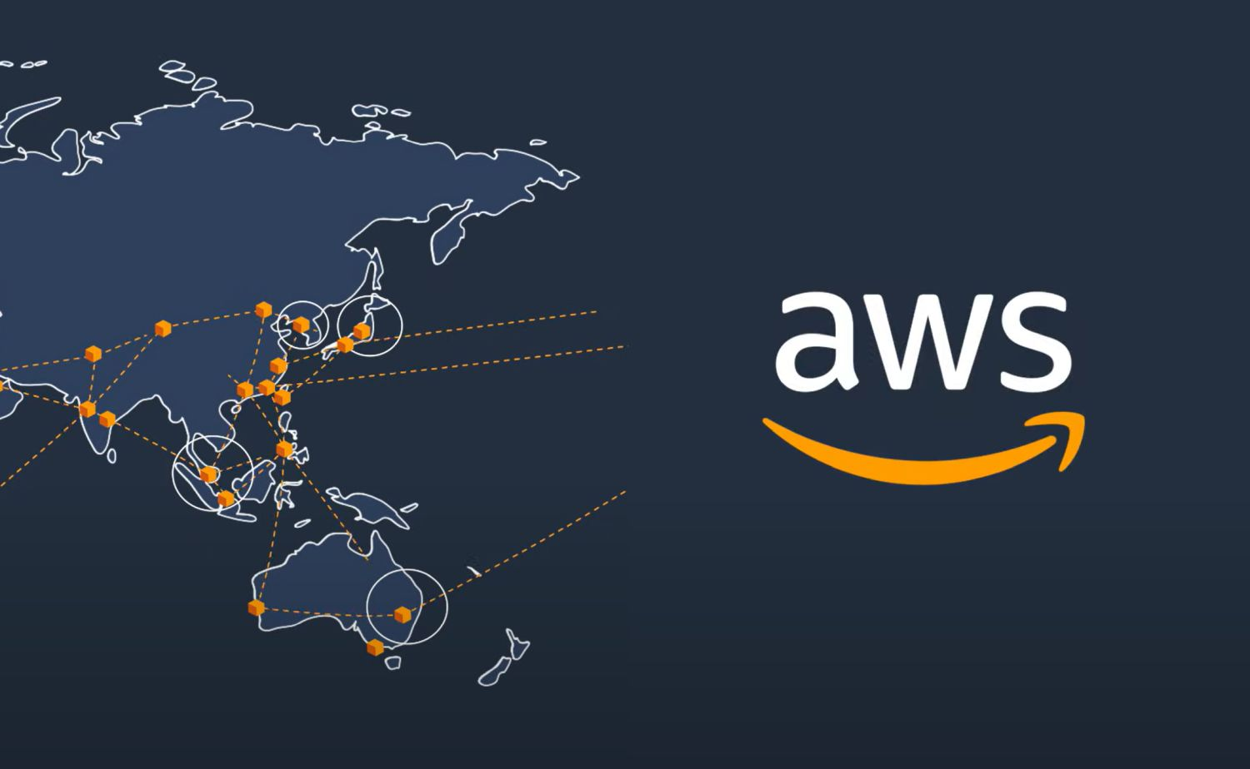
Project 10: Creating A VPC Peering Connection
Presented By: Ahmed Khaled Ahmed

Slide 14
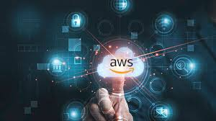
Project Overview
This project demonstrates how to create a private VPC peering connection between two VPCs.
VPC peering allows secure and private communication between resources in different VPCs.
By the end of this project, you will have established a peering connection, configured routing, enabled flow logs, and tested the connection.
Project Tasks:
Create a VPC peering connection between two VPCs.
Configure route tables to utilize the VPC peering connection.
Enable VPC Flow Logs to monitor network traffic.
Test the VPC peering connection.
Analyze VPC flow logs for traffic insights.

Slide 15
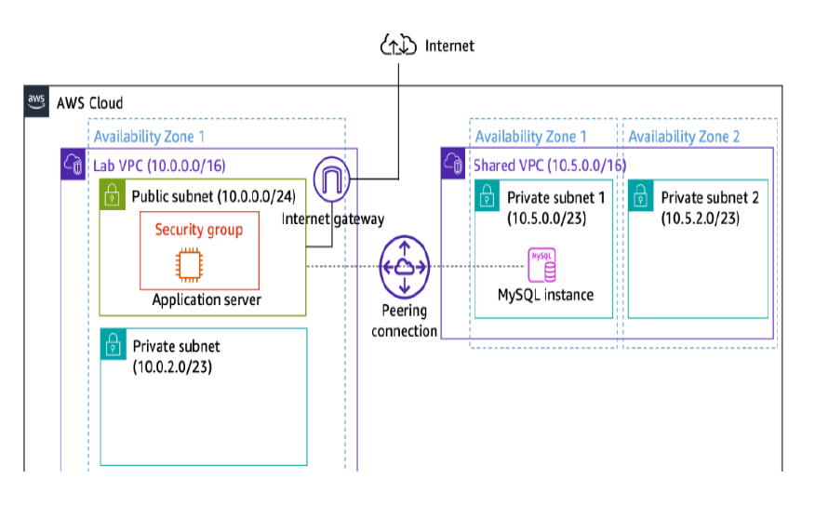
Project Diagram

Slide 16
VPC peering
What is a vpc ?
What is vpc peering connection ?
Types of peering connection .
Both are in the same region & same account .
Different region & same account .
Same region & different account .” file sharing “
Different region & different account

Slide 17
Editing route table & Testing
VPC Peering: Connected Lab VPC (10.0.0.0/16) and Shared VPC (10.5.0.0/16).
Route Tables:
Lab VPC routes traffic to Shared VPC (10.5.0.0/16).
Shared VPC routes traffic to Lab VPC (10.0.0.0/16).
Verified communication between the Lab VPC's application server and the Shared VPC's MySQL instance.
Accessed the application using the public IP of the EC2.
input the database connection details (endpoint, database name, username, and password).

Slide 18
Enabling & analyzing VPC flow logs
VPC flow logs
capture information about the IP traffic.
published to Amazon CloudWatch Logs.
Retrieved log records in the log group.
Analyzing
log entries with port 3306, representing traffic between the application server and the database.

Slide 19
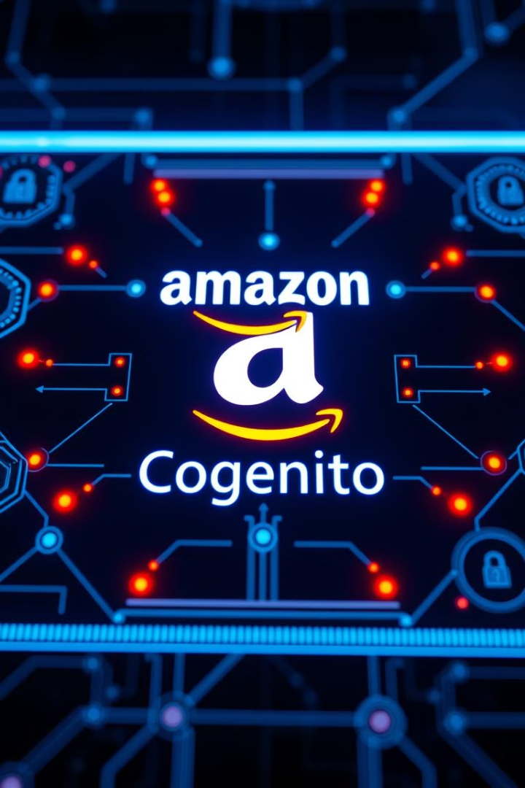
Project 11: Securing Applications Using Amazon Cognito
Yousef Presented by: Yousef Ashraf Ashraf Abdo Aboelwafa

Slide 20

Application Security Challenges
1
User Authentication
Verify user identities securely and efficiently.
2
Access Management
Control and monitor resource access effectively.
3
Multiple Identity Providers
Integrate various authentication sources seamlessly.

Slide 21
Amazon Cognito Overview
User Pools
Identity Pools
Third-Party Integration
Manage user directories and authentication.
Grant temporary AWS service access.
Support for Google, Facebook, and more.

Slide 22
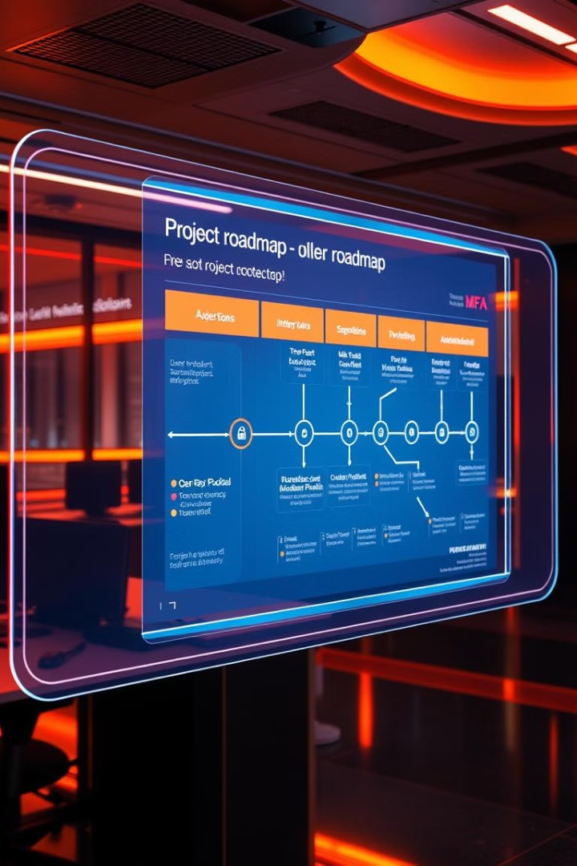
Project Goals
1
User Pool Implementation
Set up secure user authentication system.
2
Identity Pool Configuration
Enable temporary AWS service access.
3
MFA Integration
Enhance security with multi-factor authentication.

Slide 23
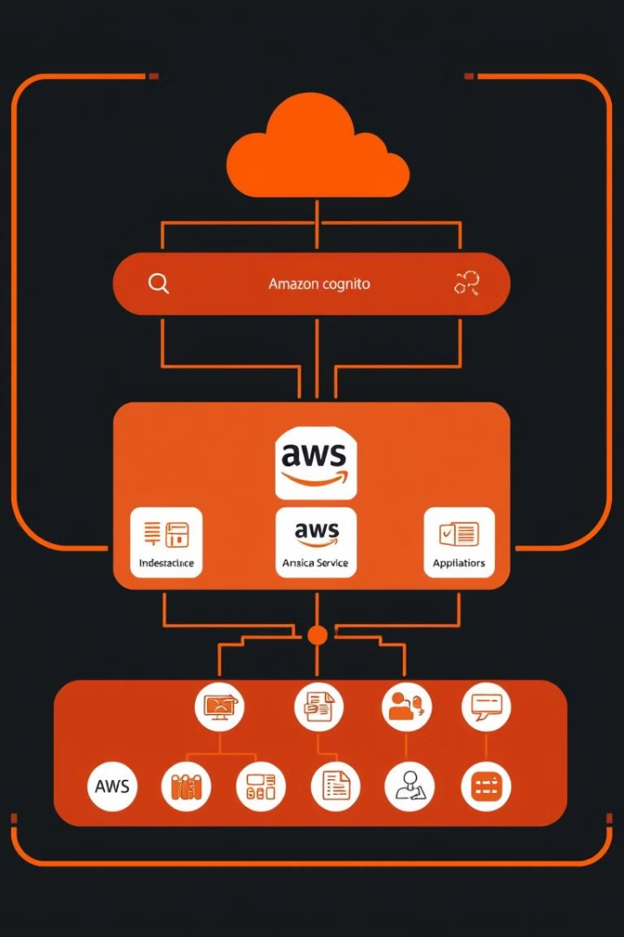

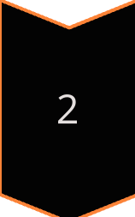

Solution Architecture
User Request
Application receives authentication request.
Cognito Validation
Credentials verified against user pool.
AWS Access
Authorized users granted temporary service access.

Slide 24
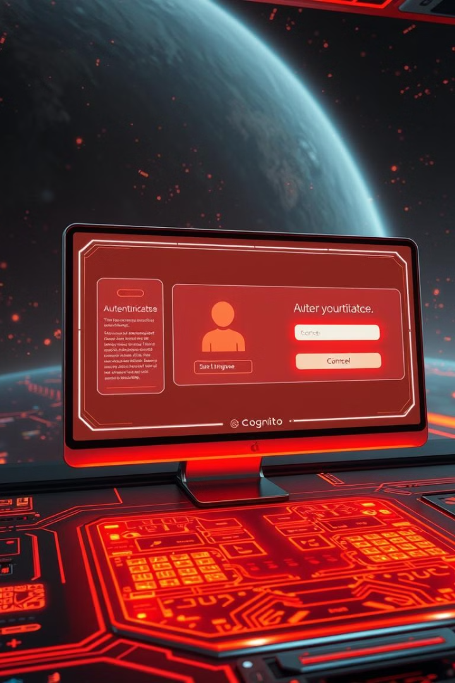
User Authentication Flow
1
Credential Entry
User inputs login information.
2
Cognito Verification
User pool validates credentials.
3
Token Issuance
Valid users receive access token.

Slide 25
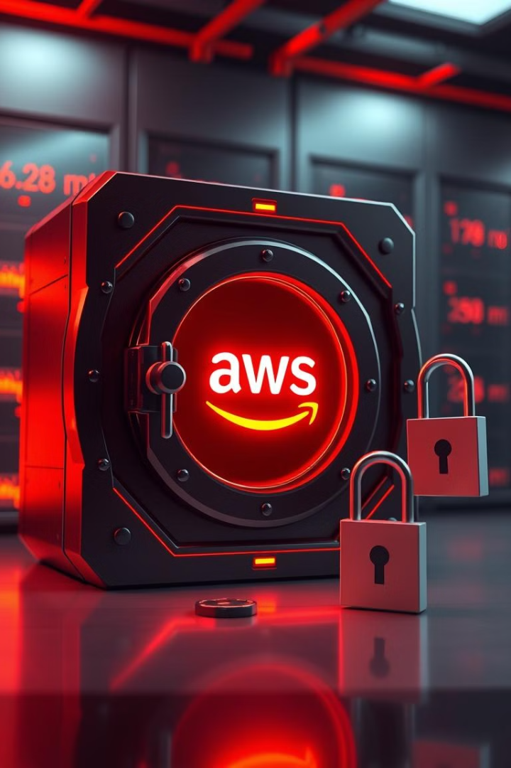
Securing AWS Resources
Temporary Credentials
Identity pools provide short-lived AWS access.
Fine-grained Access
Control permissions for specific AWS services.
Scalable Security
Easily manage access for growing user base.

Slide 26




Multi-Factor Authentication
Password
Traditional first-factor authentication.
OTP
Time-based one-time password as second factor.
Biometrics
Optional additional factor for enhanced security.

Slide 27
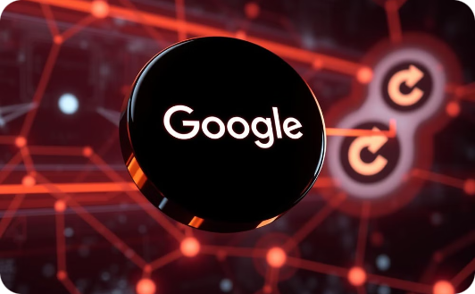


Third-Party Identity Providers
Google Integration
Facebook Integration
Expandable Options
Seamless login using Google credentials.
Quick access with Facebook account.
Support for additional identity providers.

Slide 28
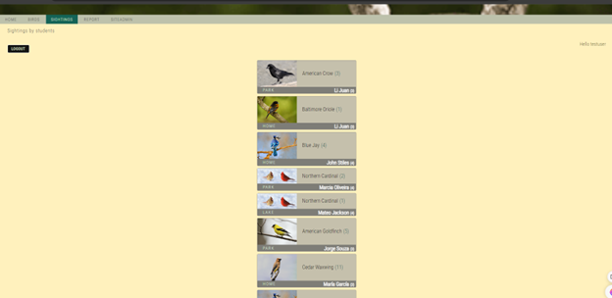
Testing the user pool integration
This test proves that only a user who has been authenticated by the Amazon Cognito user pool can access the protected pages of the application.

Slide 29

Lessons and Challenges
Challenge
Lesson
MFA Configuration
Importance of thorough testing
Third-party errors
Robust error handling crucial
AWS resource management
Effective use of IAM policies

Slide 30
Questions

Slide 31
